Slide 1

Analyzing Company Sales
Presented by: Octave Antoni
Last Updated: June 30th, 2022

Slide 2
Table of contents
Introduction
Dataset
Key figures
Correlation analysis
Conclusion

Slide 3
Introduction
Project based on Captain Book (dummy) data
Brick and Mortar Store ➔ recently expanded by going online
Main objective ➔ Target new areas of growth
Analysis of sales data, highlighting key figures
Bivariate analyses ➔ Measuring correlation

Slide 4
Dataset

Slide 5
Dataset
Dataset = 3 csv tables :
customers.csv : Data on the gender and birthdate of each customer. Key : client_id
products.csv : Price and category of each product. Key : id_prod
transactions.csv : client_id, id_prod and date information. Key : session_id (several lines per sessions if many items bought)
Limitations :
Categories are not mentioned, only numbers are given (0-1-2)
No information on products apart from price and category
Client information limited to birthdate and gender
No explanation for the sharp drop in sales in October

Slide 6
Data cleaning
Test data has to be removed
Negative price product
Converting the date column of the transactions DB into datetime
Data imputation about a product with missing information

Slide 7
Key figures

Slide 8
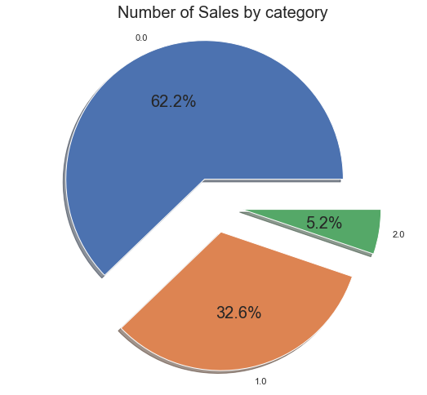
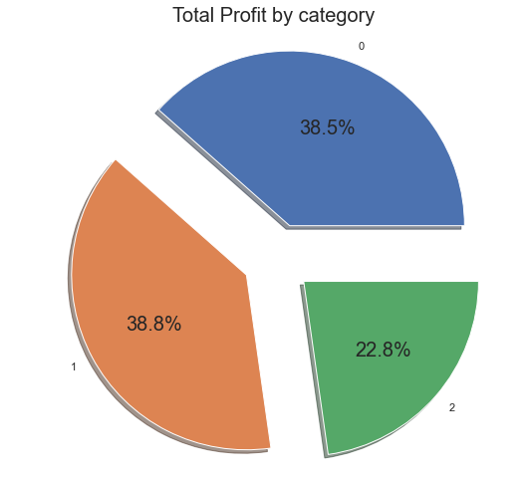

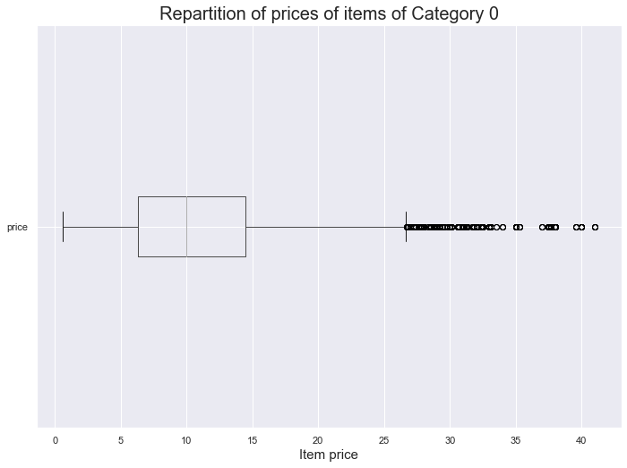
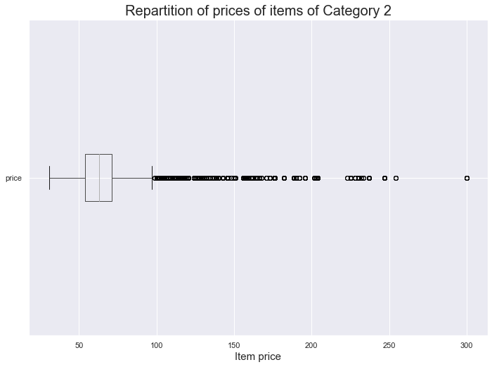
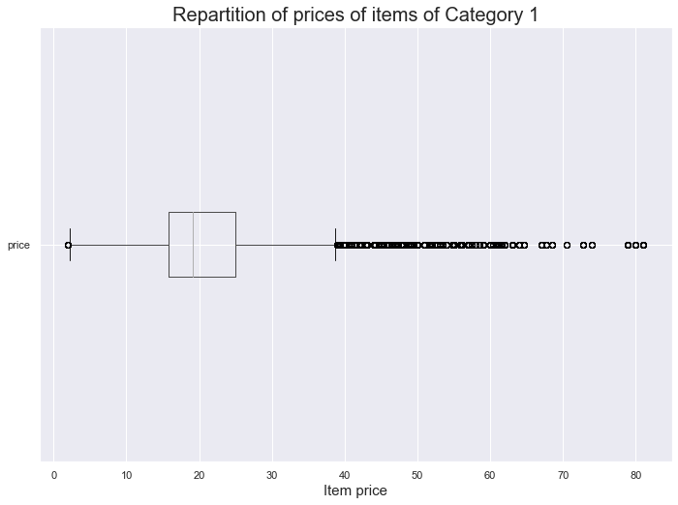
Sales and profits by item category
% of Sales by category
% of Profits by category
Category 0 items represent 2/3^{rds} of sales ➔ most sold category
Category 2 items represent only 5% of sales but 23% of profits ➔ Most profitable
Category 1 items represent 1/3rd of both profits and sales
Median price of Cat2 items much higher than Cat1 and Cat0
Cat0 Price Boxplot
Cat2 Price Boxplot
Med = 10
Cat1 Price Boxplot
Med = 63
Med = 19

Slide 9
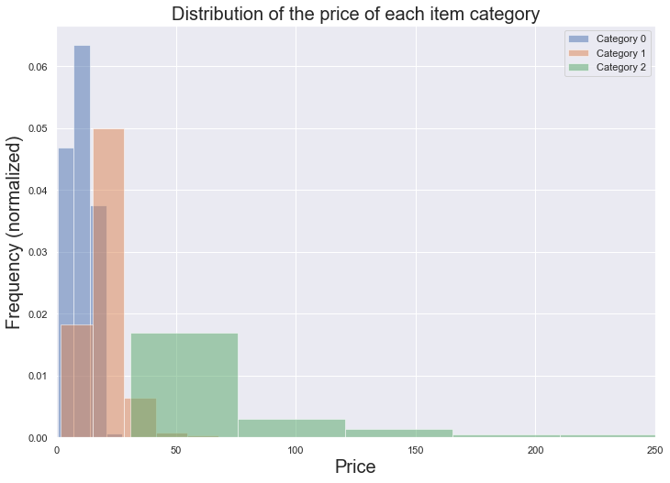
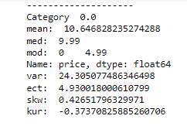
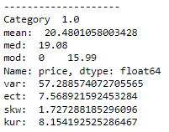
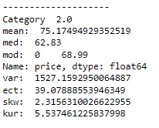
Dispersion of price by category (1/2)
Different categories of items have very different average and median values
Category 0 has the lowest average and median value, while category 2 has the highest average and median.
Category 1 items are in the middle but they are closer to Category 0 items in average and median

Slide 10
Dispersion of price by category (2/2)
Category 0 items have a low variance and standard deviation (24 / 5)
Category 2 items have a very high variance (1527) and standard deviation (39) in their prices
Category 1 items have an average variance (57) and standard deviation (7,5)
Both Cat1 and Cat2 items have high peaks (kurtosis) and a moderate right skew while Cat0 items have low kurtosis and skewness (<0,5)

Slide 11
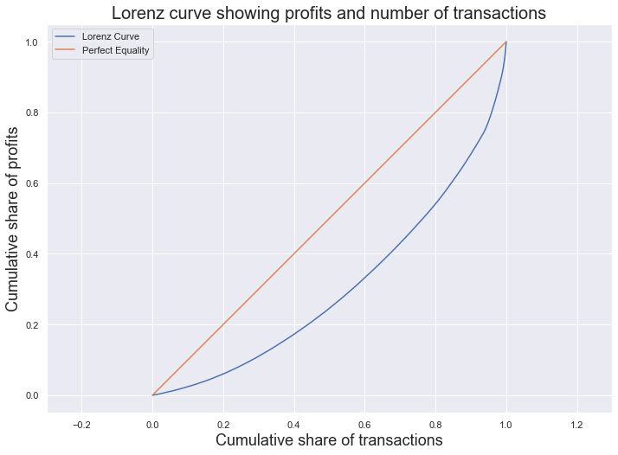
Concentration of price
Inequal concentration of profits ➔ 20% of transactions represent 45% of profits
Gini index : 40%
Growth opportunity ➔ Increase the value of low price transactions to diminish inequalities
55%
80%

Slide 12
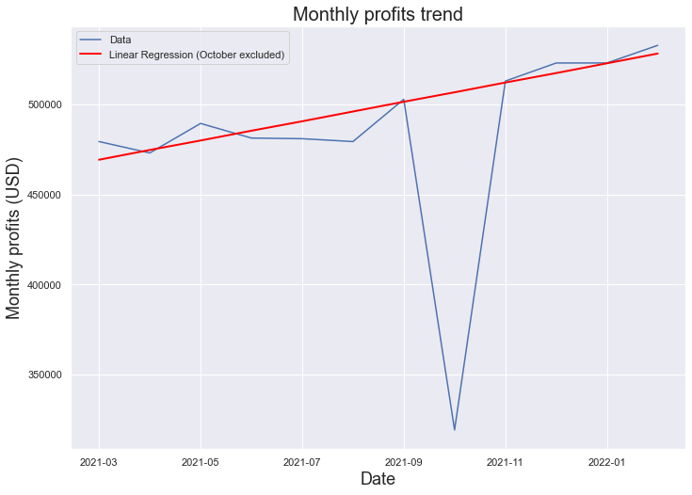
Profits trend
Profits are trending up
Big profit drop in October ➔ Caused by a sharp drop in items of Category 1 sold
Linear rise in profits ➔ r = 0.93
11% yearly growth in monthly profits

Slide 13
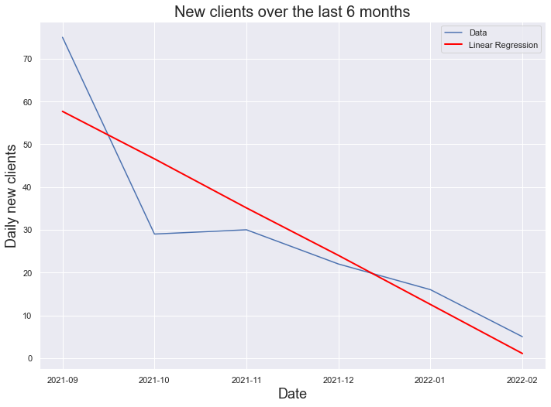
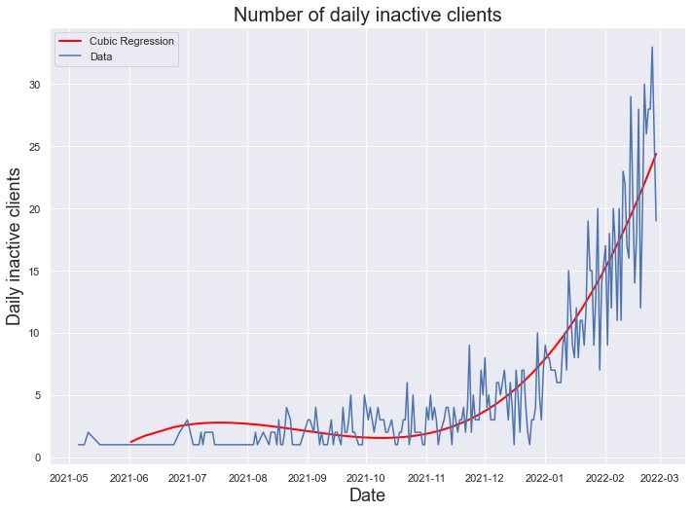
New and inactive clients
Ten-fold decrease in number of daily new clients over last 6 months
Significant increase in the number of inactive clients since January (+600%)
Current number of daily new clients near 0
Leading indicators for company growth ➔ Improving retention and acquisition rate priority

Slide 14
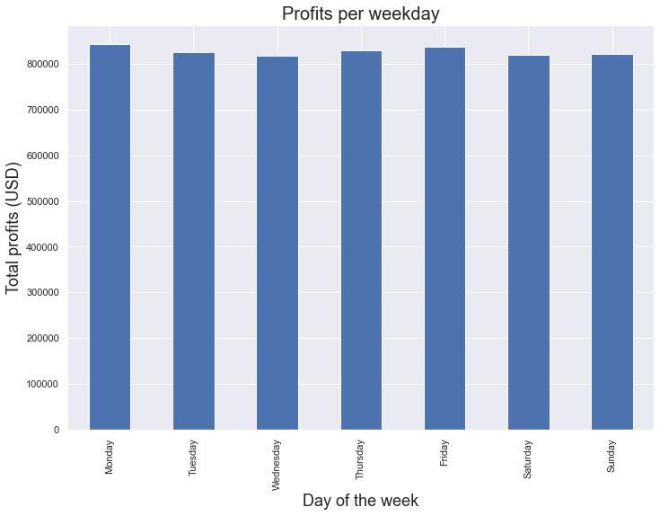
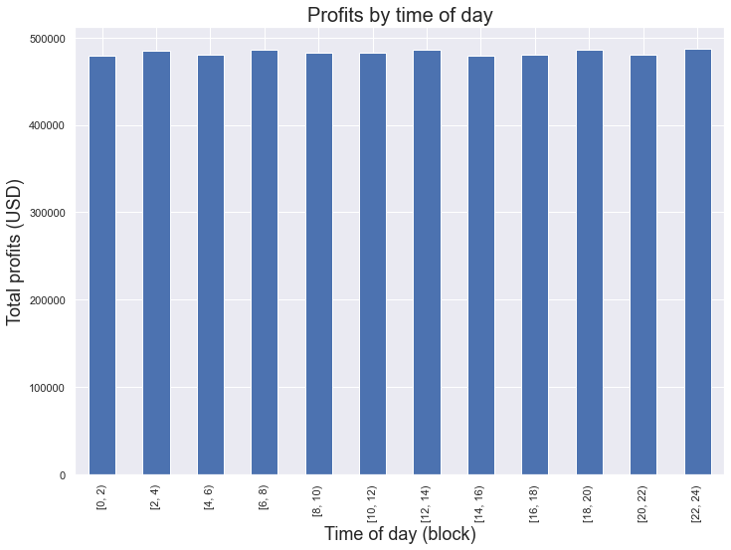
Weekday and time of day
No correlation between weekday and profits (eta² = 0.0)
No correlation between time of day and profits (eta² = 0.0)
➔ No interest in targeting specific days or time blocks in marketing strategy

Slide 15
Correlation Analysis

Slide 16
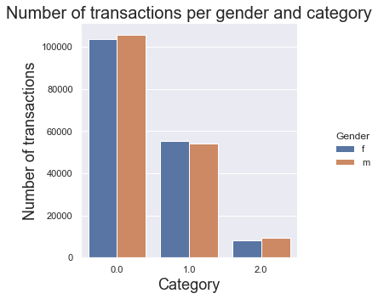
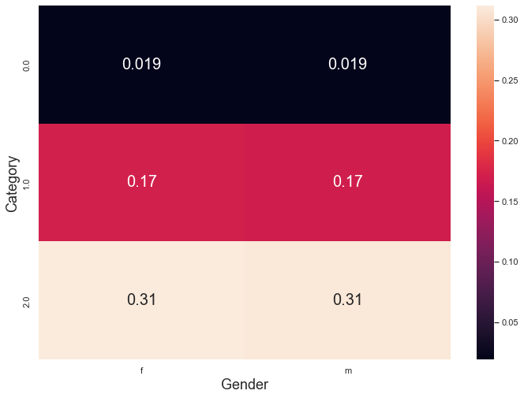
Gender and category of items bought
Strong correlation between gender and item category bought
Chi² = 81.87 (p < 0,01, 2 degrees of freedom)
Category 2 biggest contributor to non-independence
Category 0 biggest contributor to independence

Slide 17
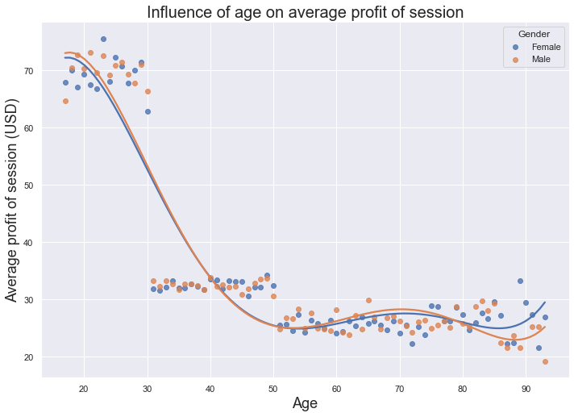
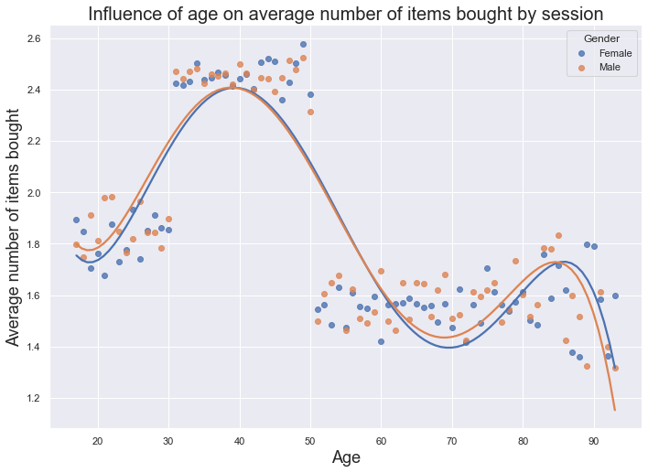
Influence of age on profits and items bought
Strong correlation between age and average profit (r = 0,76)
Customers aged 17-30 twice as profitable as other customer groups
Moderate correlation between age and number of items bought (r = 0,57)
Customers aged 31-50 buy 40% more items
Marketing strategy ➔ Target young customers and increase basket value of customers 31-50

Slide 18
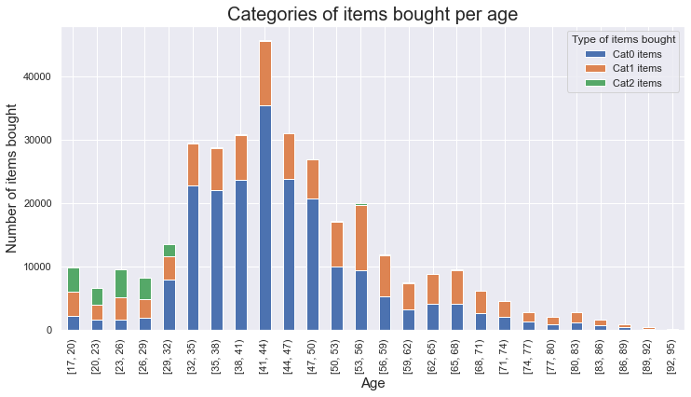
Item category and age
Weak correlation between age and item category bought (eta = 0,35)
Category 2 items only bought by 17-30 age group (high correlation between age and Cat2 items sold)
41-44 top buying age group
After 50, decrease of the number of total items bought, high percentage of Cat1 items bought
New markets ➔ Sell Cat2 items to people over 30 and increase number of Cat0 items sold to 50+

Slide 19
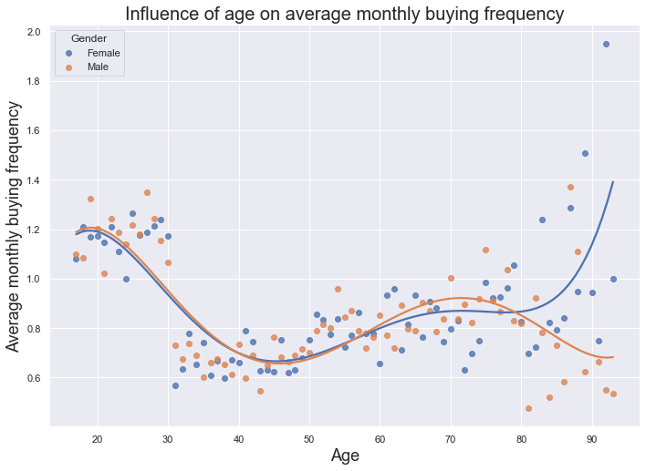
Buying frequency and age
No significant correlation between age and buying frequency (r = 0,16)
Buying frequency is higher for people under 30 and over 80 ➔ valuable customers
Females > 80 have a particularly high monthly buying frequency
Marketing opportunity ➔ Elderly women have a high buying frequency

Slide 20
Recommendations

Slide 21
Recommendations
First priority ➔ Increase customer retention and new customer acquisition
17-30 age group should be targeted in priority (highest average basket value)
Increase basket value of people 31-50 (top buyers)
Category 2 items (most profitable) should be marketed to all age groups
Low sales to people over 60, but elderly women seem to be especially valuable clients
New markets ➔ Elderly people, category 2 items for people over 30

Slide 22
Questions?

